Slide 1
Windows Tech Series Applications and Updates
Speaker 1
Title
Speaker 2
Title

Slide 2
Agenda
Day | Day 1 Deployment | Day 2 Management | Day 3 Security | Day 4 Windows for CSP
 |  |  |  | Deployment | Management | Security
Synopsis | Module 1 – Introduction | Module 1 – Base System Setup | Module 1 – Analysis Of Common Threats | Module 1 – Windows for SMB Partners
 | Module 2 – Applications & Updates | Module 2 – Configuration | Module 2 – Hardening Windows | Module 2 – Windows Ent. Subscription
 | Module 3 – Windows as a Service (WaaS) | Module 3 – Managing Client Devices | Module 3 – Advanced Threat Protection | Module 3 – Deployment
 | Module 4 – Browsers & Internet Security | Module 4 – Advanced management options I | Module 4 – Information Security (AIP/WIP) | Module 4 – Managing Updates
 | Module 5 – Secure Boot & Device Guard | Module 5 - Advanced management options II | Module 5 – Internet Security

Slide 3

Applications and Updates
Scenarios for App Deployment
Strategies for Application Compatibility

Slide 4
App Deployment Scenarios

Slide 5
App Scenarios
Core Applications
Apps incorporated into Image
Store Apps
Deploying with a Task Sequence
Windows Store for Business (get slides)
Intune App Provisioning
Click-2-Run (C2R) Apps
Deploying with Task Sequence
Keeping up-to-date

Slide 6
Core Applications
Major Line of Business Applications
Infrequent Updates
Used by majority of users
Common Developer Frameworks and Runtimes
Application Frameworks and Runtimes
Data Access Components
Common Helper Apps
Acrobat Reader
XML Notepad
7-Zip

Slide 7
Store Apps
Deploying with a Task Sequence
To sideload,
Use APPX Bundle from ISV, or download from the Windows Store for Business
Stage in Deployment Share and add installation task
Can include in Windows images
Windows Store for Business
Processes for online and offline deployment
Integration with MDM/MAM
App Updates provided by Windows Update or MDM

Slide 8
Click-2-Run (C2R) Apps
Deploying with Task Sequence
Stage C2R bits, run C2R in a Post-Deployment Task
Keeping up-to-date
Most C2R are self-updating (Office 365)

Slide 9
App Deployment Scenario labs Module 01-03: Prepare for deployment with MDT 2013 Update 2 Module 01-09: Deploy Office 365 ProPlus as part of an operating system image Module 01-11: Using the Windows Store for Business with MDT 2013

Slide 10
Application Compatibility Strategy

Slide 11
A Pragmatic Application Compatibility Approach
High Risk Transitions
Low Risk Transitions
Building a Risk Continuum
Assessing Application Risk
Developing a Test and Remediation Approach
Notes:
App Compat is all about management of risk. In previous operating system migrations, it was one of the largest sources of risk. Organizations strive to understand and manage that risk.
By classifying the risk associated with certain applications and certain types of transitions, we can create a more pragmatic approach to assessing application compatibility for a typical enterprise.

Slide 12
High Risk Transitions
Large, Complex Transitions
Windows XP to Windows 7/8.1
Critical/Custom LOB Applications
Collect
Analyze / Rationalize
Test / Remediate
Notes:
For most organizations, moving from Windows XP to Windows 7 was their last experience in migrating to a new operating system, and in this transition, we saw an average of 21% of applications require some form of touch. While many touches were simple (for example, modifying the application installer to remove a check for the version of Windows you are running), the challenge was nonetheless often hard because of:
The sheer volume of applications – many organizations found that they had thousands, and sometimes tens of thousands of applications in the environment
The occasional complexity of remediation – often, an organization would (sensibly) begin with its largest and most complex applications, and project that the complexity of solving that problem might be representative of the complexity of the rest
The support conundrum – determining whether or not an app worked sometimes didn’t matter when support was required for the capability but not provided in that version of the app

Slide 13
Low Risk Transitions
Windows Updates
Windows as a Service Updates
Deploy to team
Deploy to floor
Deploy to building
Deploy to city
Deploy to country
Deploy to world
Notes:
It’s important to note and observe that not all operating system transitions experience the same risk exposure. In fact, most organizations have even more experience dealing with lower risk transitions, as they get to practice this transition once a month: Windows Updates.
While generally focused on patching security issues, Windows Updates are nonetheless modifying Windows components, and have a small, but non-zero risk of app compat impact. But since the risk is sufficiently small, most organizations don’t conduct exhaustive testing. Given that the typical app compat assessment project in a large organization would often take 12-18 months, it’s hard to fit that into a monthly cadence!

Slide 14
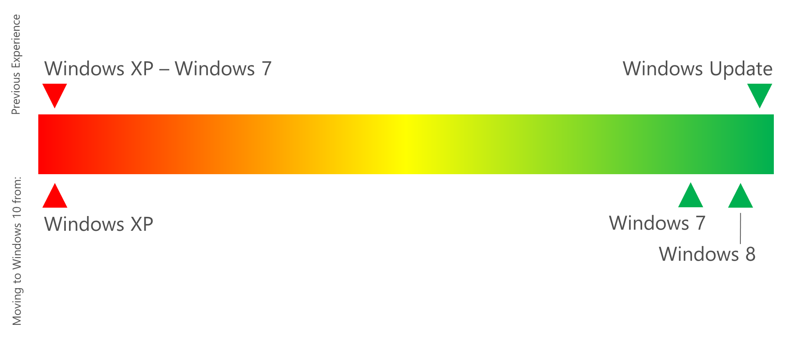
Building a Risk Continuum
Notes:
Given the different approaches presented, what Microsoft recommends is disrupting existing approaches. We believe it no longer makes sense to have two discrete approaches to managing app compat: the Upgrade and Patch approach. This is an artificial separation, after all – patches are just a subset of upgrades. The introduction of a new box, or of a new version number, doesn’t add risk – only the introduction of code which impacts app compatibility adds risk, and this can happen anywhere (or nowhere).
Here, for example, is the risk continuum we have observed for transitions to Windows 10 so far:
(See image on slide)
For customers who are moving to Windows 10 from Windows XP, the risk is very similar to the risk of moving to Windows 7 from Windows XP. In fact, for some organizations, it can be even higher; most Windows XP devices today are running that OS not because of unknown compatibility impact, but because of known incompatibilities.
For customers who are moving from Windows 7, working with early adopters, we have observed an average failure rate of around 2%. This is dominated by hard coded version checks for Windows 7. Note that this number is still early and may not be representative of your findings, but is nonetheless instructive when it comes to strategy.
For customers who are moving from Windows 8, working with early adopters, we have observed an average failure rate of a fraction of a percent. This difference from Windows 7 is explained by the fact that, beginning with Windows 8.1, we began lying about the version of Windows by default. Again, these are early findings with relatively low sample sizes, but should nonetheless be instructive in developing smart risk management decisions.
Given this continuum of risk, what we want to establish is a more systematic way to approach management of that risk. Before, we presented only two scenarios – how can we broaden this to discrete intermediate steps? To do this, we will next describe our taxonomy for both assessing application risk and for testing applications.

Slide 15
Assessing Application Risk
App Compat Risk | Characteristics | Typical Distribution
Critical | Typically, complex custom development or highly customized commercial software. App failure can lead to loss of life or irreparable organizational harm. No acceptable workarounds for failure are identified. | 2%
High | Typically, complex custom development or highly customized commercial software. App failure can lead to significant loss of productivity or ability to execute organizational mission. Workarounds can take days or weeks to implement, and/or come at a significant cost. | 18%
Medium | Typically, commercial software that is current or a recent version, and is commonly used at other organizations using the target platform; or custom development following straightforward patterns. App failure can be addressed with reasonable workarounds that take minutes to hours to implement and which use standard helpdesk procedures. | 50%
Low | Typically, commercial software that is up-to-date and supported on the OS you are moving to, or is custom development that was created and/or tested on the target platform. Vendor is accountable for remediating compatibility issues, or organizational mission can be accomplished without the software on a temporary basis. App failure can be addressed with simple workarounds through standard helpdesk procedures. | 30%
Notes:
Defining and assessing application risk is often not trivial. If you ask most business owners to identify the criticality of the software they are using, we have found that the most typical result is to discover that 85% of all software is defined as business critical.
We believe this is mostly driven by a lack of agreed upon criteria for software criticality, combined with the abstract fear that, if not defined as critical enough, either testing or future funding is potentially at risk. Regardless of the motivation, the results are predictable: by defining everything as important, you are defining nothing as important. We prefer to differentially invest in software based on risk.
We have successfully used this taxonomy, along with a recommended distribution of software within this taxonomy, to help drive a deeper understanding of where app compat risk exists. It’s important to note that we’re not trying to define business impact – lower ranking here doesn’t mean the app is less important, it merely means that it’s less at risk for app compat failure!
Leveraging this taxonomy, we have seen customers driving much more consistent behavior and smart investment against the risk of app compat impact in a migration.

Slide 16
Defining Testing Approaches
Approach | Description
Regression | Users or business owners perform end to end testing to validate all critical scenarios driven by the application. App must pass all tests to be considered compatible. Typical accuracy rate 99%.
Smoke | Users or business owners come to labs or run on their own devices and test a few scenarios to get a gut feel of whether the software appears to be working. Typical accuracy rate 95%.
Automated | Application is run through test automation or static analysis (where available) to predict compatibility based on attributes of the application. Typical accuracy rate 20% - 60%.
Pilot | Application is deployed to pilot users or group technical coordinators to integrate into daily workload, while backup devices are made available in the event of application failure. Typical accuracy rate 85%.
Reactive | Application is deployed to end users on the new platform, with guidance and help desk scripts for responding to production failures that leverage existing helpdesk procedures. Typical accuracy rate 99%.
Notes:
We now need to define the testing approaches we might leverage to help to manage that risk. Being able to define a variety of means to perform testing is important to be able to invest commensurately with risk.
This is the most typical taxonomy we see used to define testing approaches: (See chart)
Note that, while Pilot and Reactive have high accuracy rates, they find app compat issues post-deployment, while the other 3 approaches have an objective of discovering issues prior to deployment. So, it’s important to work that into your strategy based on where you can sustain temporary outages, whether in pilot or production scenarios.

Slide 17
Assigning Testing Approaches
Windows XP → Windows 10
App Compat Risk | Regression | Smoke | Automated | Pilot | Reactive
Critical | 100%
High | 20% | 30% | 50%
Medium |  | 10% | 20% | 30% | 40%
Low |  |  | 10% | 20% | 70%
Windows 7 → Windows 10
App Compat Risk | Regression | Smoke | Automated | Pilot | Reactive
Critical | 100%
High |  | 20% |  | 70% | 10%
Medium |  | 5% |  | 35% | 60%
Low |  |  |  | 10% | 90%
Notes:
With our risk taxonomies now clearly defined, we can start to assign testing approaches to each of our risk profiles.
Here is a sample of one assignment grid, where we were specifically attempting to manage the risk of applications we were migrating from Windows XP to Windows 10: (See chart)
We built a very similar grid, but instead shifted to accommodate the different risk of migrating from Windows 7 to Windows 10: (See chart)

Slide 18
Upgrading to Windows 10
Technical Debt
Enabling UAC and Transitioning to Standard User Context
Transitioning to 64-Bit Windows
Enabling UEFI to enable sophisticated Security Features
Test Upgrade in Place
Good option for Windows 7/8.1 → Windows 10 where “Technical Debt is paid off”
Supporting Windows as a Service
“Ring” Approach to testing and deployment
Application Compatibility Approach can be more like “Windows Update”

